Slide 1
Programming Structures in MATLAB
MODULE FIVE

Slide 2
Control Structures
Introduction
Types and Applications
Control structures are essential in directing the flow of execution in a program.
Are fundamental building blocks of any programming language
Facilitate logic implementation and task repetition as needed
They allow one to;
  make decisions (conditional execution)
  repeat code (loops)
  select between different sections of code based on the program state.
Conditional Statements (if, elseif, else): Execute code based on logical conditions.
Switch Statements (switch, case, otherwise): Executing one block of code among many alternatives based on the value of a variable or expression.
Loops
  for loop: Repeats a block of code a specified number of times, iterating over a range of values
  while loop: Repeats a block of code as long as a condition remains true.
Control Flow Modifiers
  break: Exits the loop prematurely when a condition is met.
  continue: Skips the remaining code in the current iteration of a loop and moves to the next iteration.

Slide 3
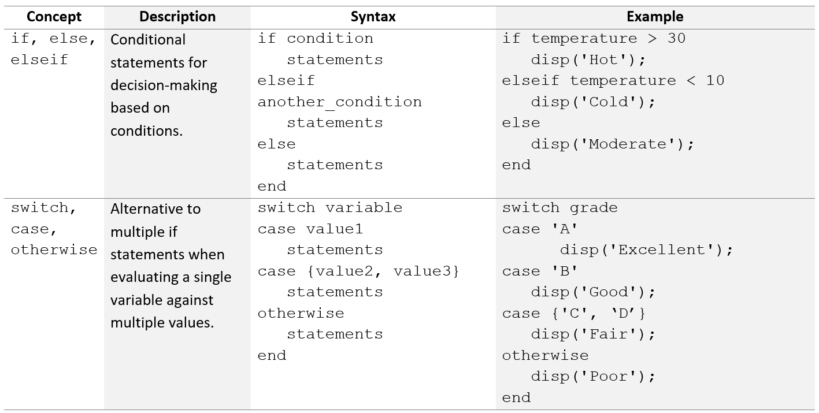
Decision Statements

Slide 4
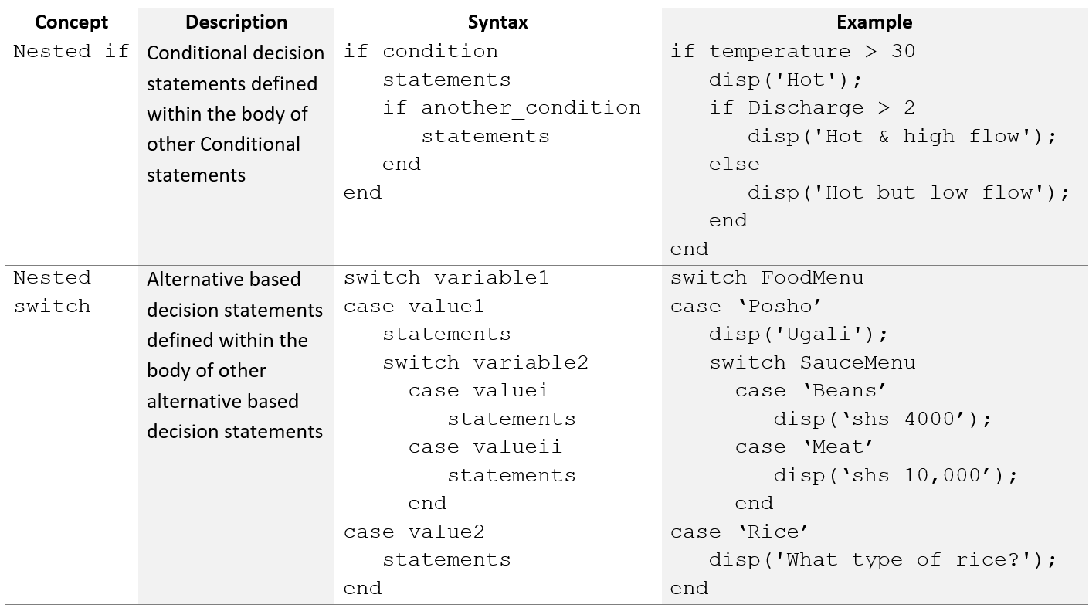
Nested Decision Statements

Slide 5
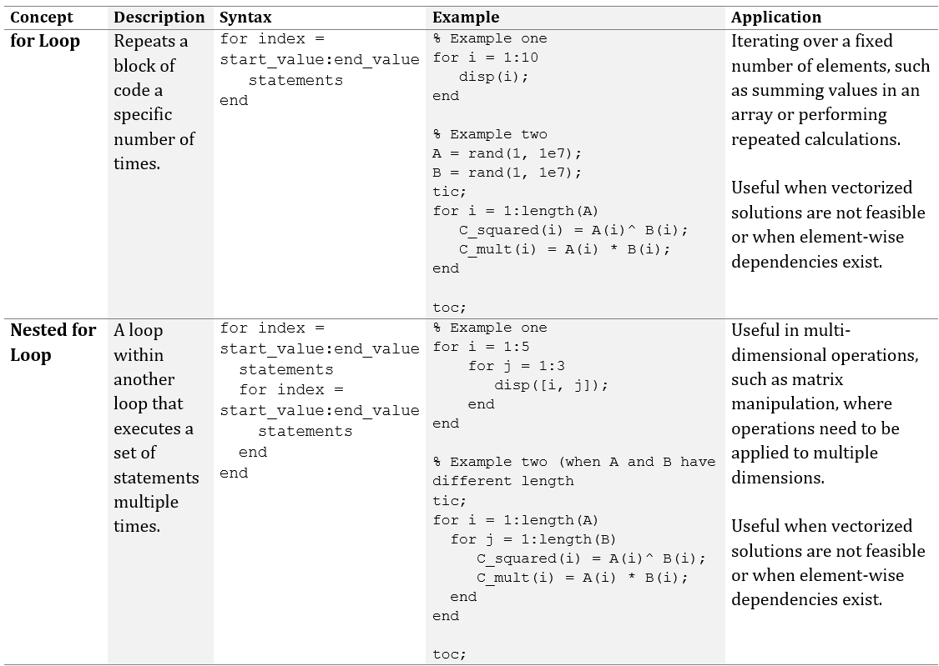
For Loops

Slide 6
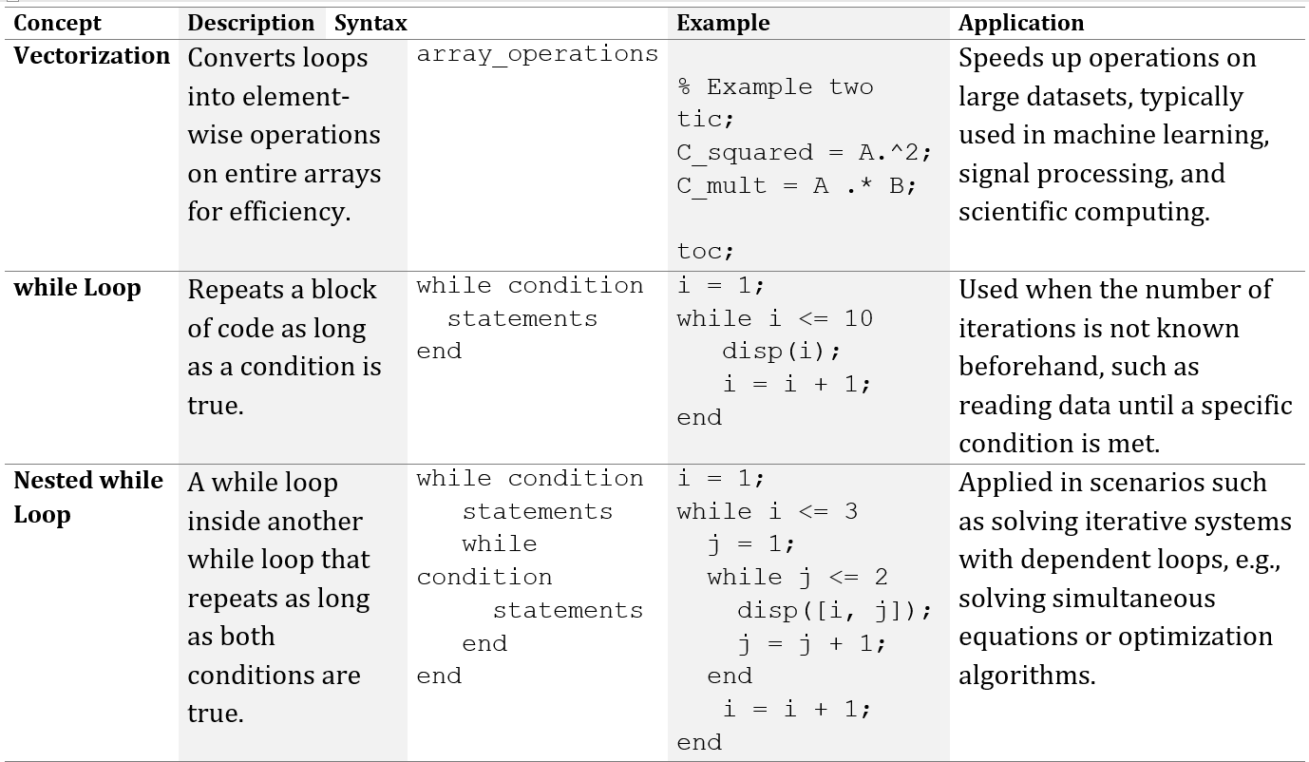
While Loops

Slide 7
Introduction to Programming paradigms
Overview
Programming Paradigms Applications
Programming paradigms define the ways in which code is structured, organized, and executed
Each programming paradigm has its advantages and is suitable for particular types of tasks.
Different paradigms have evolved over time to address;
  Various types of problems
  Provide different levels of control
  Modularity and efficiency
Understanding these types of programming is essential for selecting the right approach for a problem or project.
Unstructured programming is simple but unsuitable for large programs
Modular programming and Object-Oriented Programs enhance reusability and scalability.
Recursive programming simplifies code for problems with a self-similar structure
Dynamic programming optimizes recursive solutions for more complex problems.
Functional and declarative programming focus on expressing the logic of a problem
Event-driven programming responds to real-time events.

Slide 8
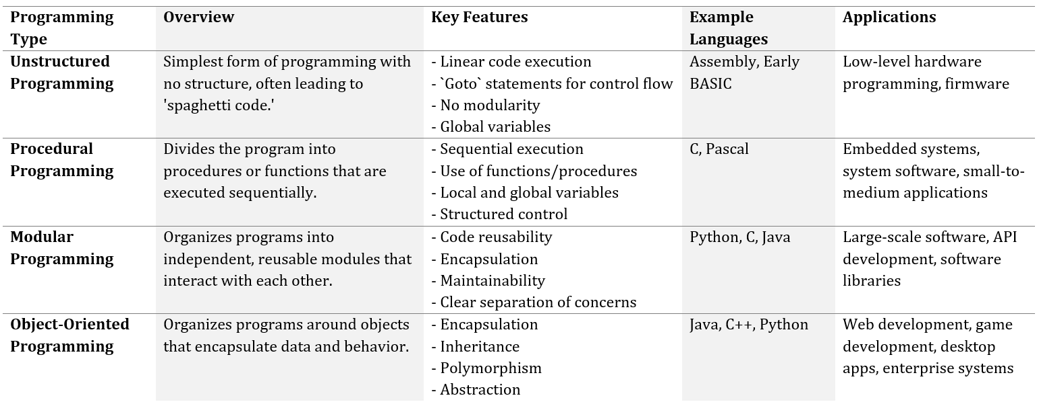
Types of Programming

Slide 9
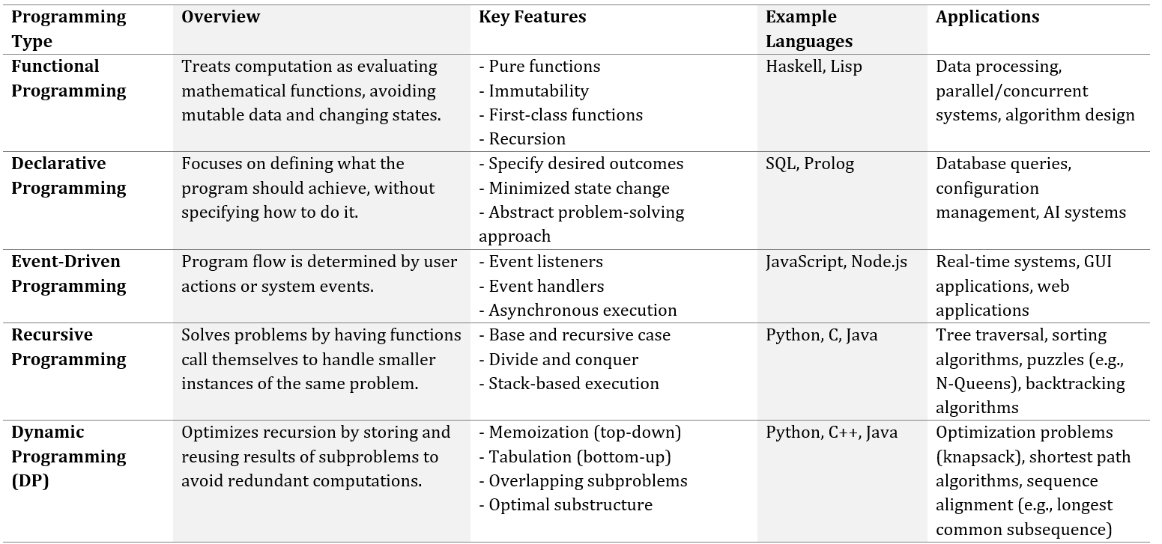
Types of Programming

Slide 10
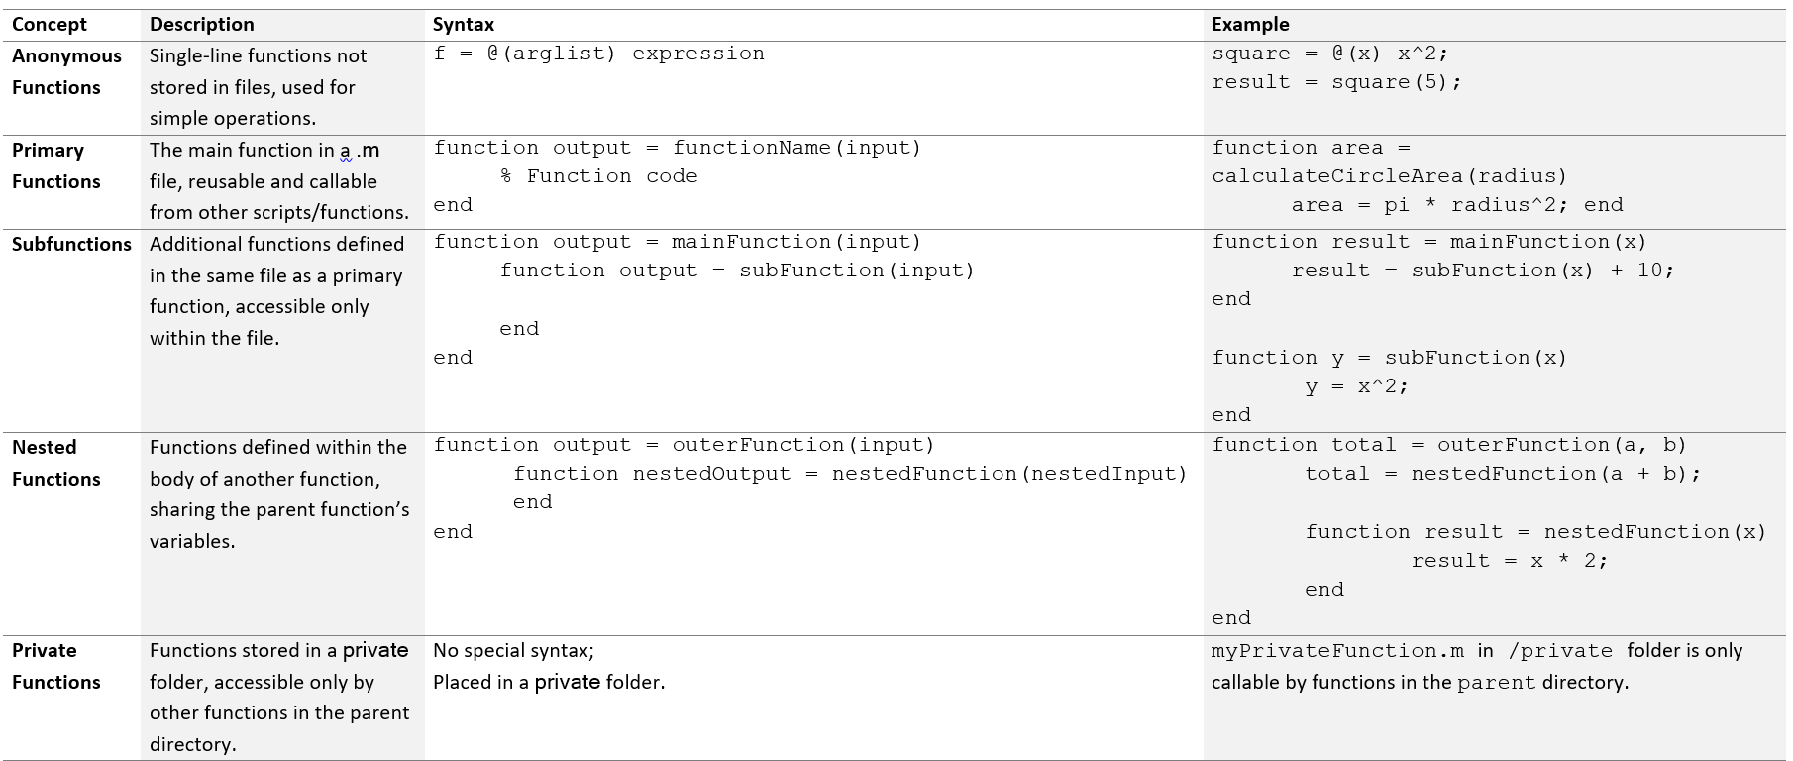
Types of Functions

Slide 11
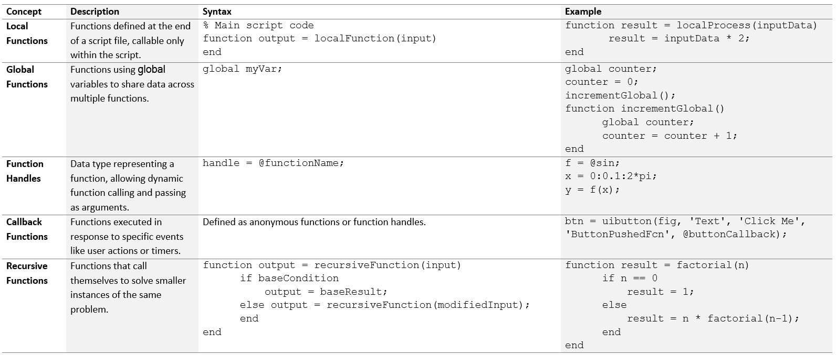
Types of Functions

Slide 12
Recursive Programming
Introduction to Recursion
Characteristics of Recursive Functions
A technique where a function calls itself in order to solve smaller instances of the same problem.
Each call typically works on a smaller subset of the original problem
Terminates when a base case is reached, where the solution is directly known
understanding its types and applications can greatly enhance problem-solving capabilities in computational tasks.
Base Case: A condition under which the recursion stops. Without a base case, the recursion would lead to an infinite loop.
Recursive Case: This is where the function calls itself with modified arguments, generally simplifying the problem in each step.
Stack Memory Usage: Recursive functions use stack memory to remember the function calls, leading to a chain of calls until the base case is met. This can sometimes lead to a stack overflow if recursion goes too deep without a base case.

Slide 13
Applications of Recursion
Merits of Recursion
Mathematical Problems: Solving problems like factorial, Fibonacci, Ackermann function
Data Structures: Recursive traversals of data structures like trees and graphs (e.g., depth-first search, in-order, pre-order, and post-order traversals).
Divide and Conquer Algorithms: Sorting algorithms like QuickSort and MergeSort utilize recursion.
Dynamic Programming: Recursive solutions can be optimized using memoization in dynamic programming.
Combinatorics: Generating combinations and permutations.
Modularity and Reusability: Solutions are often more elegant, easier to read, maintain and reuse
Problem Breakdown: Natural way to model processes involving repetition or self-similarity.
Real-Time Decision Making: Enhances system responsiveness, accuracy, real-time feedback and adjustments based on changing inputs
Demerits of Recursion
Performance: slower due to the overhead of multiple function calls and the use of stack memory.
Stack Overflow: Too deep recursion can lead to stack overflow if the base case is not reached quickly or for large inputs.
Complexity in Debugging: multi-layered function calls can sometimes be harder to debug

Slide 14
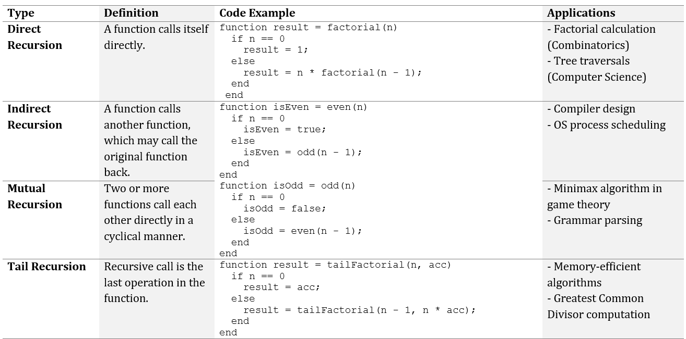
Types of Recursive Functions

Slide 15
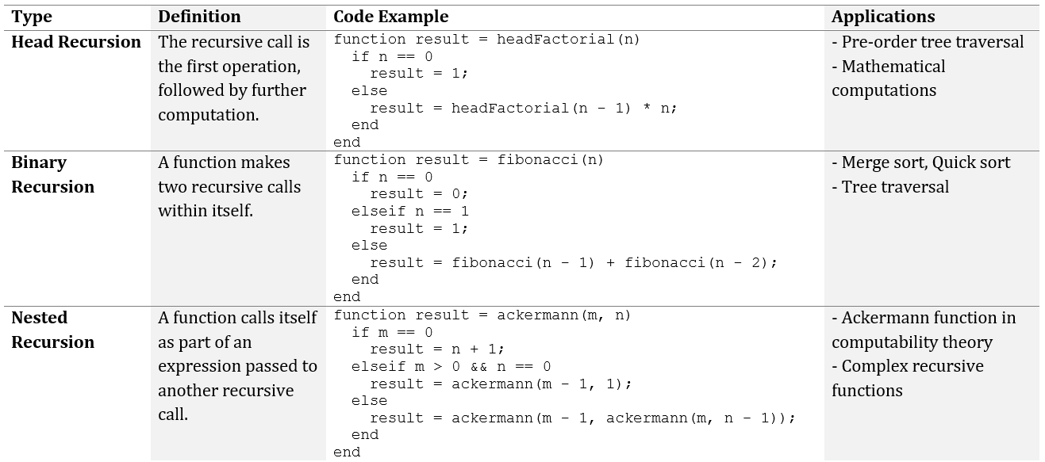
Types of Recursive Functions

Slide 16
Dynamic Programming
Introduction
Key Concepts
An optimization technique used to solve complex problems by breaking them down into simpler subproblems
Stores the results of these subproblems to avoid redundant computations.
Optimizes recursion through storage and reuse results of subproblems thus avoiding redundant computations.
Is effective when a problem exhibits An Optimal Substructure and Overlapping Subproblems
Optimal Substructure: A problem has an optimal substructure if its solution can be obtained by solving subproblems and combining their solutions.
  This property allows us to recursively define a problem in terms of its subproblems.
Overlapping Subproblems: Many DP problems involve solving the same subproblem multiple times.
  Instead of recalculating the result every time, dynamic programming stores these results to avoid redundant calculations.
Implemented through either Memoization (Top-down approach) or Tabulation (Bottom-up approach)

Slide 17
Memoization (Top-Down Dynamic Programming)
Memoization involves solving the problem recursively and storing the result of each subproblem in a cache (a data structure like a table, dictionary, or array).
This technique starts with the original problem and works its way down to smaller subproblems.
Once a subproblem is solved, its result is stored to be reused in the future.
Steps in Memoization
Start with the original problem and solve it recursively.
Check if the current subproblem has been solved before (cached).
If the result is cached, return it.
If not, compute the result, store it in the cache, and return the result.
Advantages: Ideal for problems with large inputs where only a few subproblems are necessary.
Only computes the necessary subproblems, leading to potential savings in space and time when only a portion of the DP table is needed.
Disadvantages: Recursive nature may cause high memory usage (stack space) due to deep recursion.
Can be slower due to the overhead of recursive function calls.

Slide 18
Tabulation (Down-Up Dynamic Programming)
Tabulation is an iterative method where the problem is solved by first solving all the smaller subproblems and storing their results in a table.
The solution to the original problem is built by using these precomputed results.
Steps in Tabulation
Start by solving the smallest subproblem.
Build a table where each entry corresponds to a subproblem.
Use the results of previously solved subproblems to solve the larger subproblems.
Continue this process until the original problem is solved.
Advantages:
Efficient in both time and space, as it avoids recursion.
More intuitive for problems where all subproblems need to be computed.
Disadvantages:
Requires solving all subproblems, even those that may not be necessary.
Larger memory footprint for storing the table, even if some entries are unused.

Slide 19
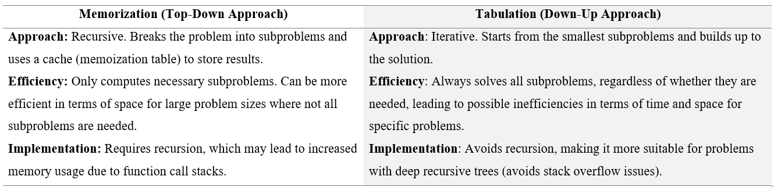
Approaches Comparison and DP Applications
Example Applications
Fibonacci Numbers: A sequence where each number is the sum of the two preceding ones, starting with 0 and 1.
0/1 Knapsack Problem: Given items with specific weights and values, the goal is to maximize the total value without exceeding a weight limit.
Longest Common Subsequence (LCS): Finds the longest sequence common to two strings.
Travelling Salesman Problem (TSP): Finds the shortest route that visits all cities exactly once and returns to the starting point.

Slide 20
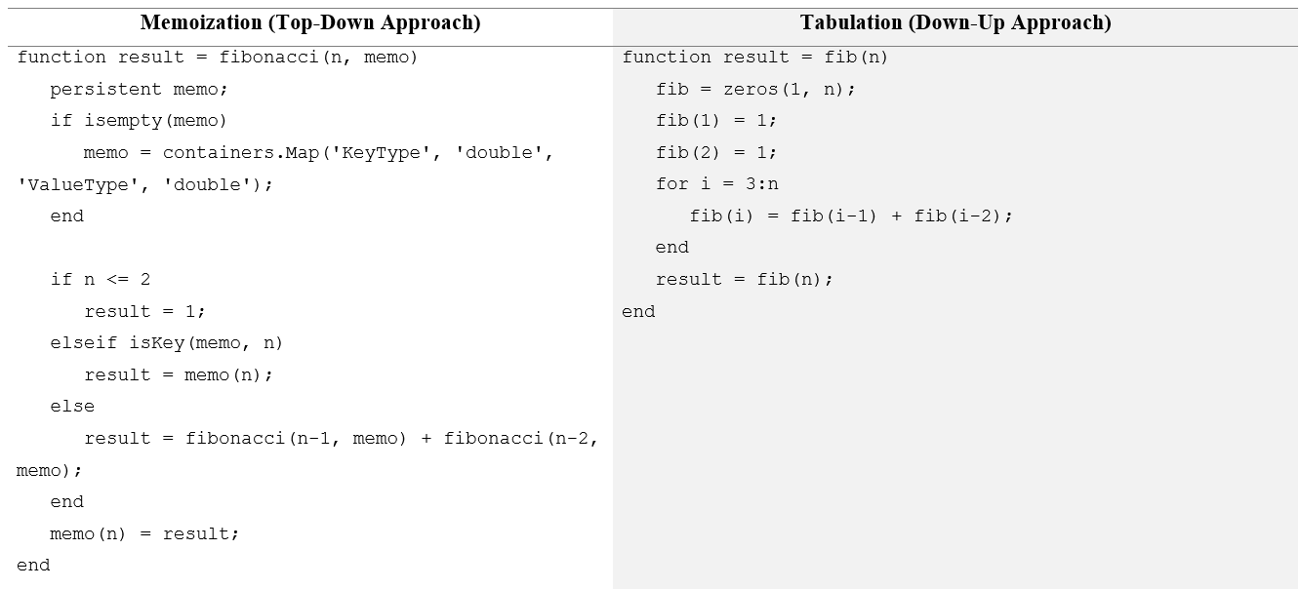
Approaches Syntax

Slide 21
Object-Oriented Programming (OOP)
Overview
Key Concepts
A programming paradigm based on the concept of “objects,” which can contain data in the form of fields (attributes or properties) and code in the form of procedures (methods or functions).
Provides a framework for structuring code in a way that enhances reusability, scalability, and clarity.
Allows programmers to structure software as a collection of objects that model real-world entities and their interactions
Classes and Objects: Classes are templates, and objects are instances.
Encapsulation: Data and methods are bundled in classes; access is controlled.
Inheritance: Classes can inherit properties and methods from other classes.
Polymorphism: Methods can be overridden in subclasses to provide specialized behavior.
Abstraction: Abstract classes define interfaces for subclasses without implementing methods.
Handle vs. Value Classes: Handle classes are passed by reference, while value classes are passed by value

Slide 22
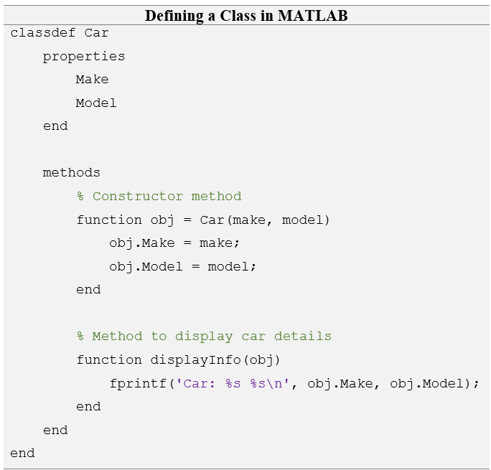
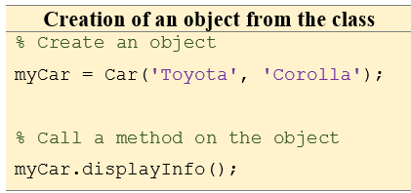

Classes and Objects
Class: A blueprint for creating objects. It defines a data structure by specifying the attributes (data) and behaviors (methods) that the object will have. They are defined with classdef and saved as .m files
Object: An instance of a class. An object is a real entity with properties and behaviors defined by its class.

Slide 23
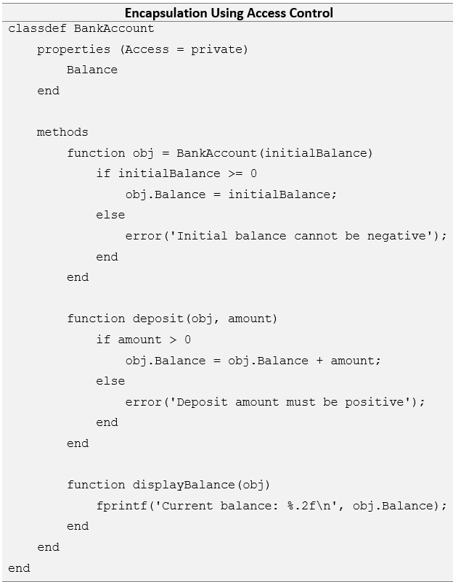
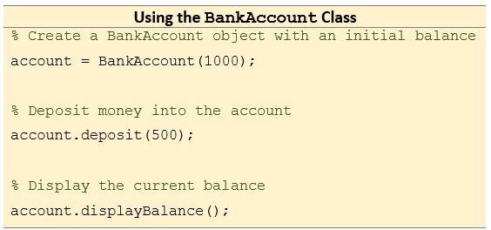

Encapsulation
Bundling of data (attributes) and methods that operate on the data into a single unit, or class.
It restricts access to the inner workings of the object and only exposes selected methods to interact with the object.
This promotes data hiding and prevents unauthorized access.
Access Modifiers for Properties or methods:
Public: Accessible from anywhere.
Private: Accessible only within the class.
Protected: Accessible within the class and its subclasses.

Slide 24
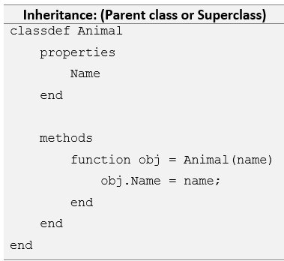
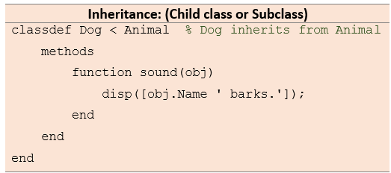
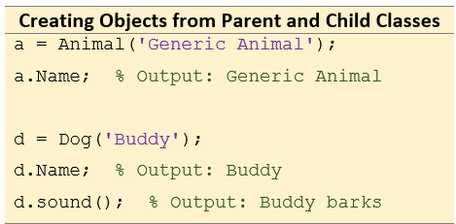
Inheritance
A mechanism by which one class (child or subclass) inherits properties and methods from another class (parent or superclass).
This promotes code reuse and establishes a hierarchical relationship between classes..
Types of Inheritance:
Single Inheritance: A class inherits from one superclass.
Multiple Inheritance: A class inherits from more than one superclass.
Multilevel Inheritance: A class inherits from a class, which is itself a subclass.
Hierarchical Inheritance: Multiple subclasses inherit from the same superclass.
Hybrid Inheritance: A combination of two or more types of inheritance.

Slide 25
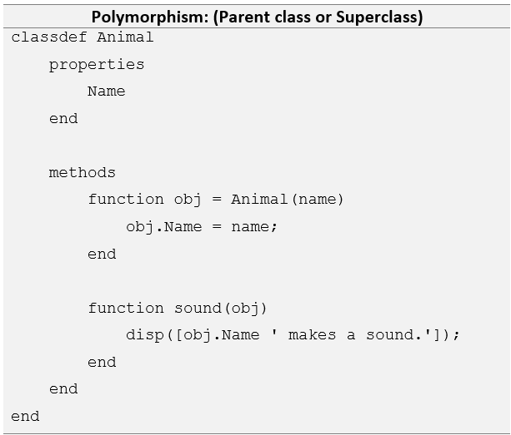
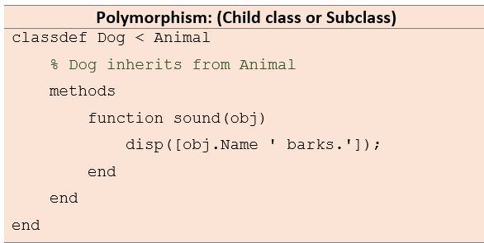
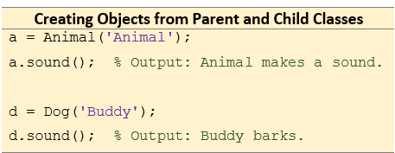
Polymorphism
The ability to define a method in the child class that has the same name as a method in the parent class but behaves differently.
Allows methods to be defined in multiple forms.
Inherited methods from parent classes can be overridden or overloaded to provide specific implementations in child classes.
Polymorphism can be achieved through:
Method Overloading: Same method name but different parameters
Method Overriding: A child class provides a specific implementation of a method that is already defined in the parent class.
In the example the sound method is overridden in the Dog Class

Slide 26
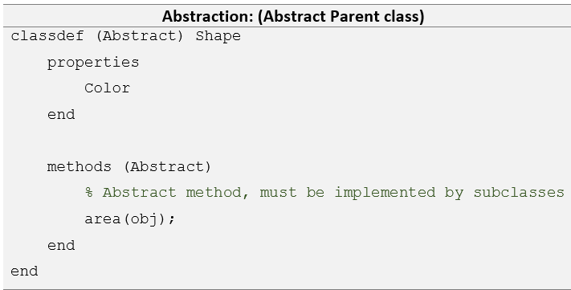
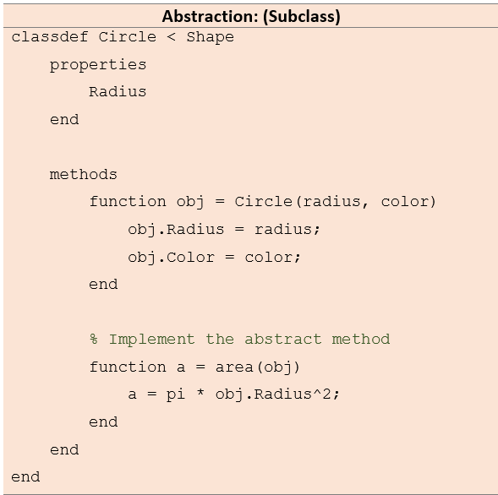
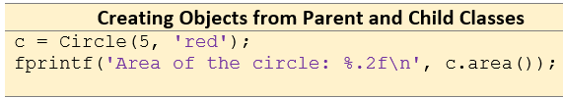

Abstraction
Hides the complexity of implementation details and exposing only the essential features of a class.
Achieved by using abstract classes and interfaces (methods)
Used to define a common interface or methods for subclasses without implementing specific functionality.
An abstract class is a class that cannot be instantiated directly
Abstract methods in these classes must be implemented by subclasses.

Slide 27
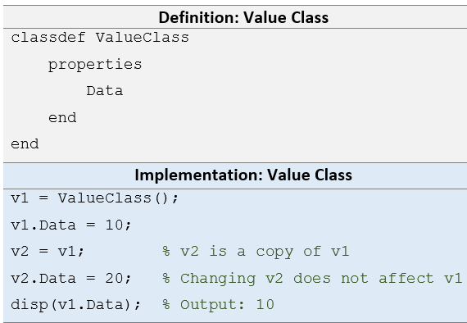
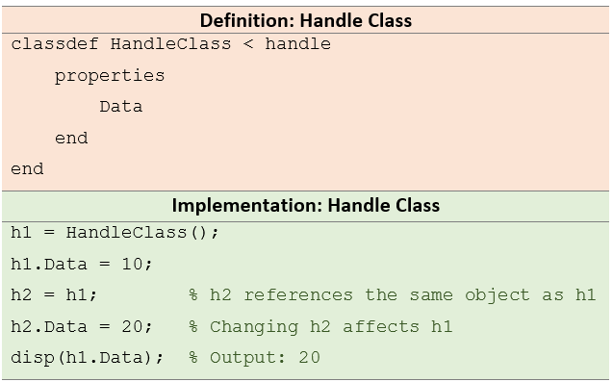
Handle vs. Value Classes
Value Classes: Objects of value classes behave like standard variables (they are copied when passed).
Handle Classes: Objects of handle classes are passed by reference, allowing changes to the object within a function to persist outside of the function.
Handle classes are passed by reference, while value classes are passed by value.
You define a handle class by inheriting from the handle class

Slide 28
Event-Driven Programming
Overview
Key Concepts
A programming paradigm where the flow of the program is determined by events—user actions (such as mouse clicks or key presses), sensor outputs, or messages from other programs.
Unlike procedural programming, which follows a fixed sequence of instructions, event-driven programs react to specific events and execute corresponding functions (event handlers).
Widely used in:
  Real-time monitoring systems: Sensors that trigger events for updates.
  Interactive simulations and Graphical user interfaces (GUIs) : User interactions trigger changes in simulation parameters.
  Automated data acquisition: Asynchronous hardware events trigger data logging or processing functions.
Event: An action or occurrence detected by the program, such as clicking a button, typing on a keyboard, or receiving data from a sensor.
Event Listener: A mechanism that waits for an event to occur and triggers a corresponding event handler.
Event Handler (Callback Function): A function executed in response to a particular event.
Event Loop: A continuous loop in the program that listens for and dispatches events to the appropriate handlers.

Slide 29
GUI, Events and Callbacks
GUI
Callbacks
GUIs are built using the App Designer, GUIDE (legacy), or through low-level programming with UIControl objects and callback functions.
Common UI components and Applications:
  Buttons: Trigger actions
  Sliders: Selection of numeric values
  Text Boxes: Text input and display
  Dropdown Menus: Select one option from a list
  Check Boxes: Enable binary selections (checked/unchecked)
Timers: For scheduling actions.
Listeners: For monitoring changes in properties.
Callback functions are executed when specific events occur.
They are linked to UI components using properties like:
  ButtonPushedFcn: for buttons
  ValueChangedFcn: for sliders, dropdowns, text and check boxes
  KeyPressFcn: for keyboard press events in figure windows
  MouseDownFcn: when mouse button is pressed
Callback functions can be defined in different ways:
  Anonymous functions.
  Function handles.
  Local or nested functions.

Slide 30
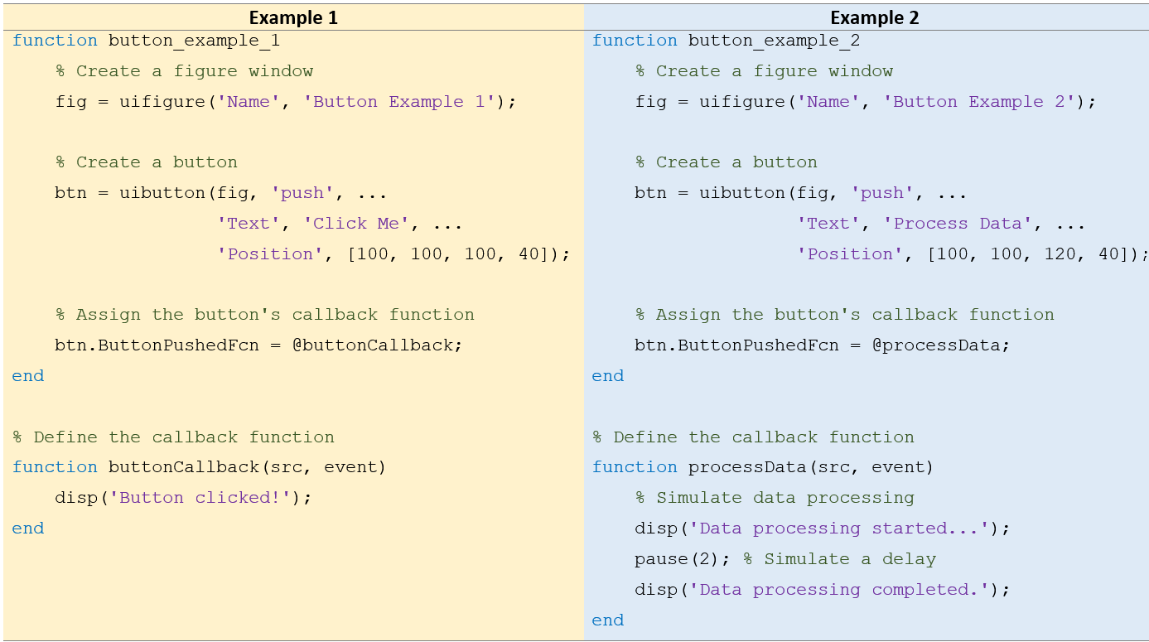
Buttons
Trigger events when clicked.
ButtonPushedFcn callback is executed when the user presses the button.
Created using the uibutton function (for App Designer or uifigure-based apps) or uicontrol for traditional figures

Slide 31
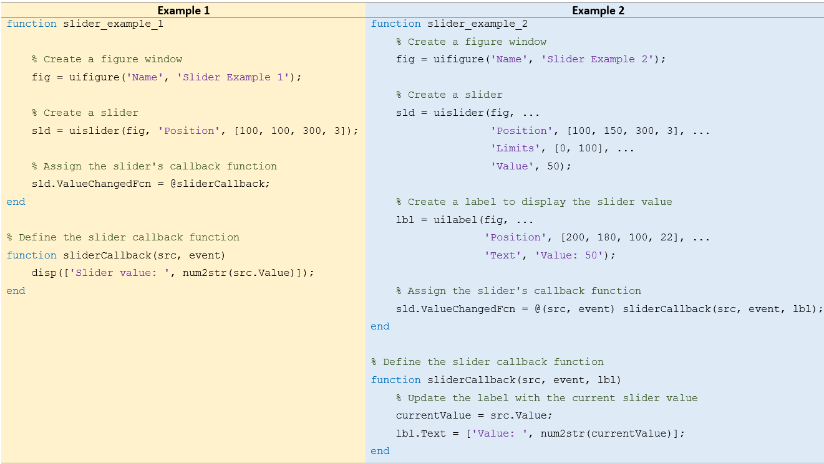
Sliders
Allows the user to select a numeric value from a continuous or discrete range by moving the slider handle
Useful for adjusting parameters interactively.
ValueChangedFcn callback that is executed when the slider is moved.
Created using the uislider function (for App Designer or uifigure-based apps) or uicontrol for traditional figures

Slide 32
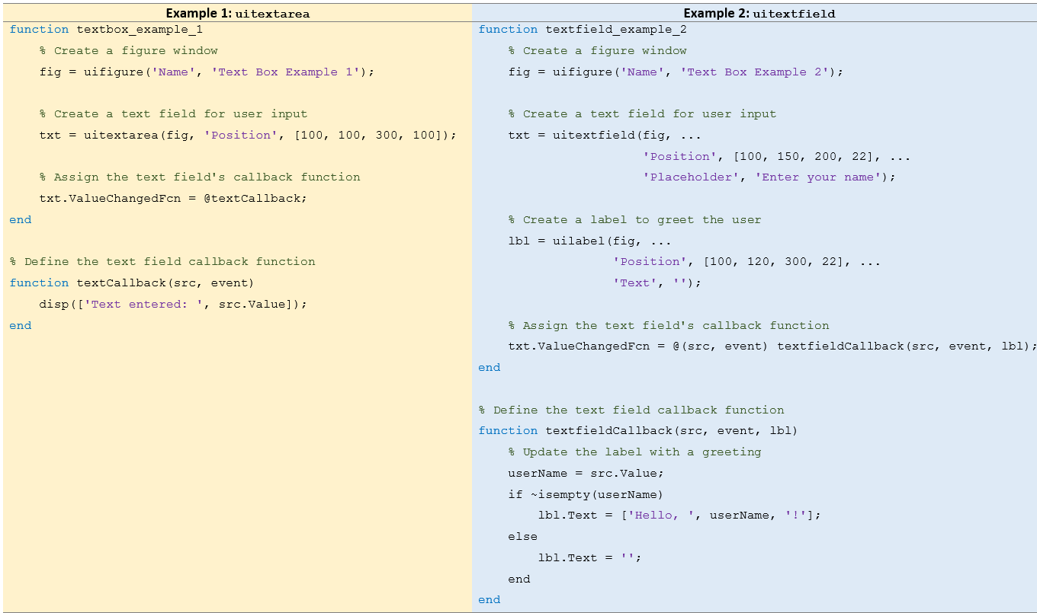
Allows the user to input or display text.
They can be single-line (uitextfield) or multi-line (uitextarea)
The ValueChangedFcn callback is trigged when the content of the text box changes.
Created using the uitextfield for single-line or uitextarea function multi-line (for App Designer or uifigure-based apps) or uicontrol for traditional figures
Text Boxes

Slide 33
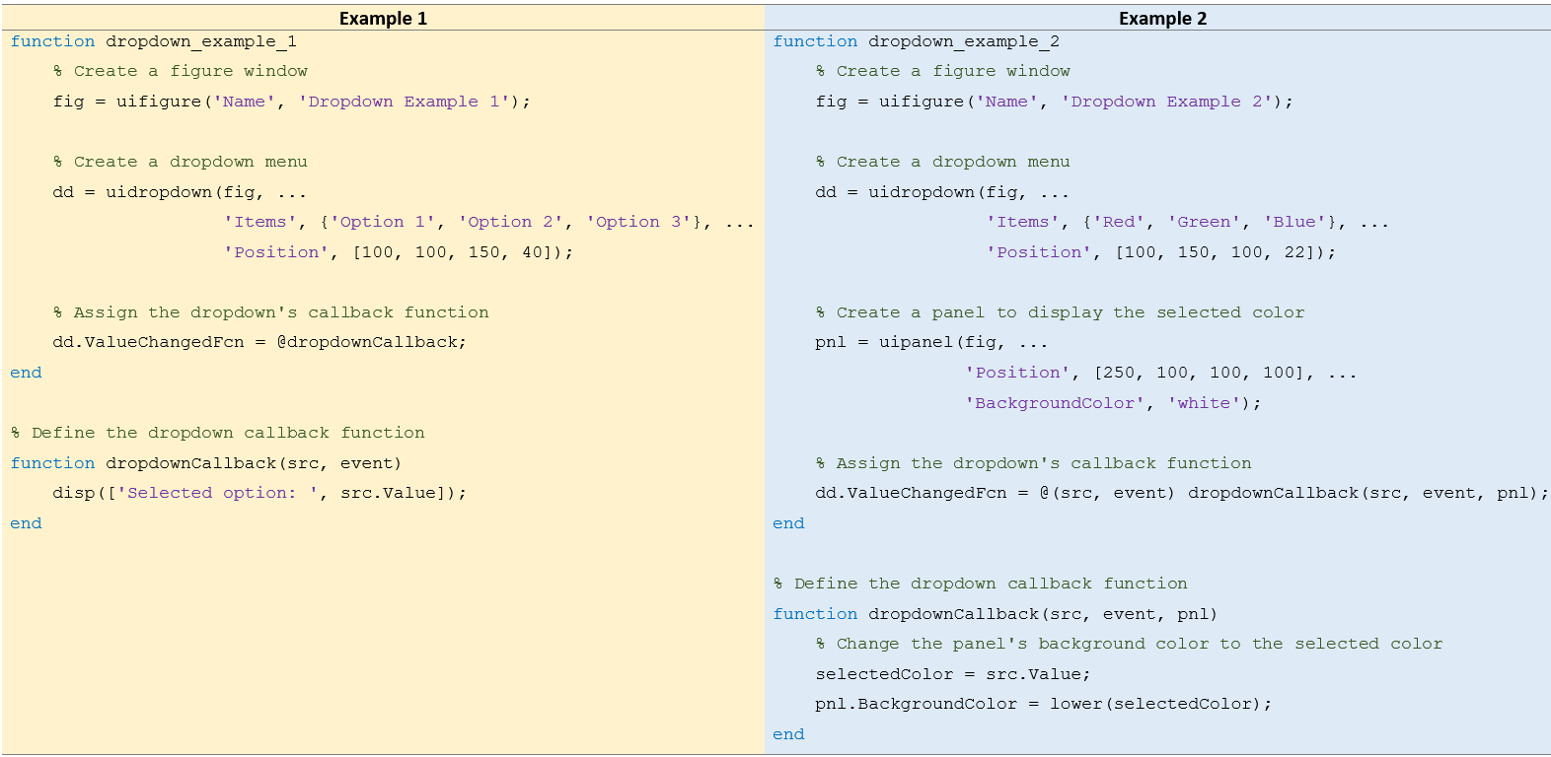
Dropdown Menus
Allows the users to select one option from a list of predefined options.
The ValueChangedFcn callback is triggered when the user selects a new option from the dropdown.
Created using the uidropdown (for App Designer or uifigure-based apps) or uicontrol for traditional figures

Slide 34
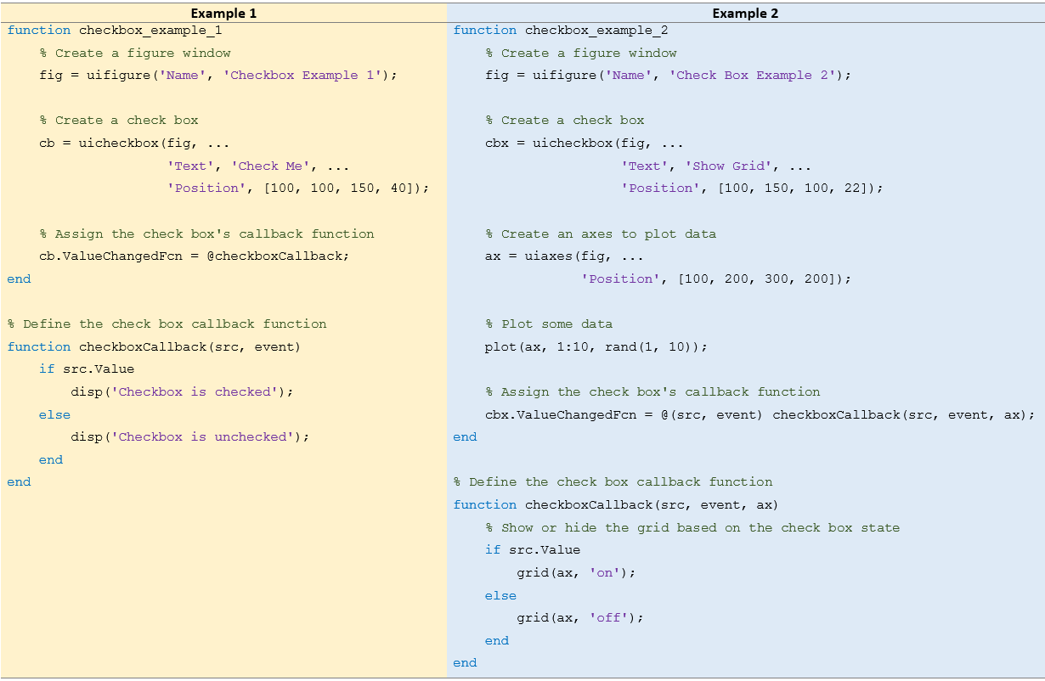
Check Boxes
Allows the users to make binary (true/false) selections. Useful for enabling or disabling options.
The ValueChangedFcn callback is triggered when the checkbox state changes.
Created using the uicheckbox (for App Designer or uifigure-based apps) or uicontrol for traditional figures

Slide 35
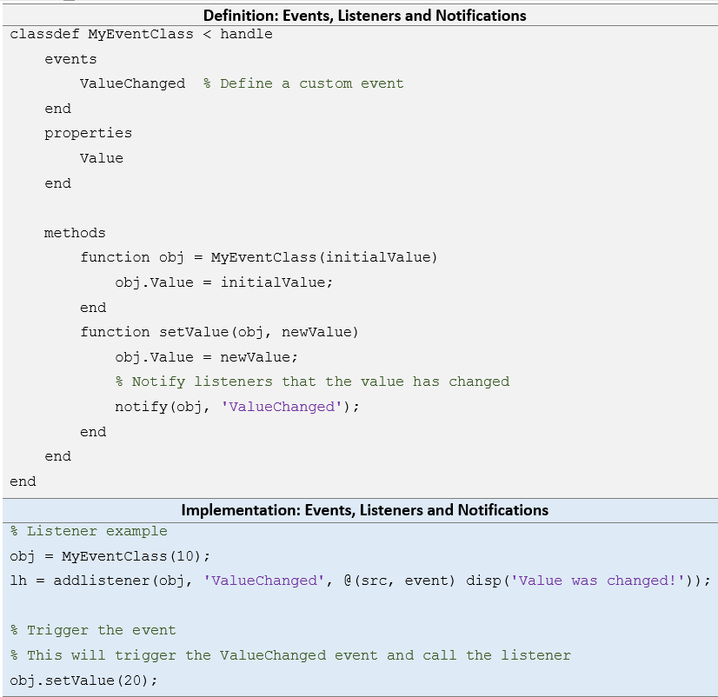
Events, Listeners and Notifications
Listeners respond to changes in the value of a property or the occurrence of an event.
It monitors an object for a specific event, and when that event occurs, a specified function (callback) is executed.
The addlistener function is used to add a listener to an object.
The notify function is used to trigger an event from within a class.
It tells MATLAB that a specific event has occurred, and any listeners waiting for this event will execute their callbacks.

Slide 36
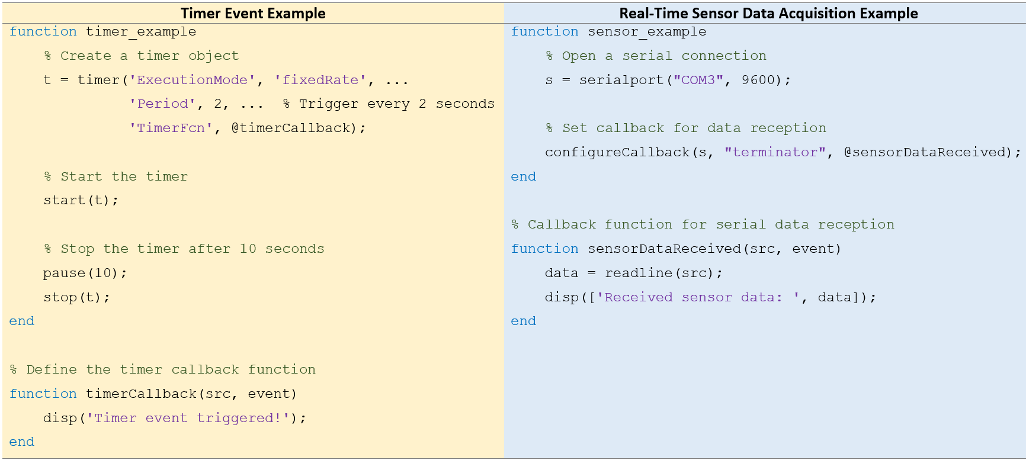
Event Loops, Timers and Serial Ports
The program enters an event loop that continuously waits for events and dispatches them to the appropriate handlers
No need to explicitly write a loop as the GUI automatically manages it internally.
Asynchronous events are triggered using callback functions that interact with hardware (e.g., timers, serial ports) upon receiving data

Slide 37
Error Handling and Debugging
Introduction
Types and Applications
Are critical skills in programming that enable developers to write robust, maintainable, and fault-tolerant code.
Error handling: ensures that the program gracefully manages unexpected conditions
Debugging: allows for identifying and resolving coding issues.
Best Practices for Error Handling and Debugging:
Write Modular Code: Split your code into small functions and test each individually.
Use Meaningful Error Messages: Provide informative error and warning messages to facilitate debugging.
Log Errors: Keep a log of errors that occur during execution for troubleshooting.
Use try-catch Appropriately: Avoid overuse; handle only specific, expected errors.
Automate Tests: Develop unit tests using MATLAB’s unittest framework to automatically check code correctness.
Types of Errors:
Syntax Errors: Code cannot be interpreted due to incorrect use of the language. Caused by missing parentheses, unrecognized variables, or improper command usage.
Runtime Errors: Occur when an operation is invalid during execution. Such as division by zero or referencing a non-existent element in an array.
Logical Errors: Don’t cause the program to fail or throw an error but lead to incorrect results. Often the hardest to detect.

Slide 38
Error Handling and Debugging
Introduction
Best Practices
Are critical skills in programming that enable developers to write robust, maintainable, and fault-tolerant code.
Error handling: ensures that the program gracefully manages unexpected conditions
Debugging: allows for identifying and resolving coding issues.
Types of Errors:
  Syntax Errors: Code cannot be interpreted due to incorrect use of the language. (missing parentheses, unrecognized variables, or improper command usage)
  Runtime Errors: Occur when an operation is invalid during execution. (division by zero or referencing a non-existent element in an array)
  Logical Errors: Don’t cause the program to fail or throw an error but lead to incorrect results. (Often the hardest to detect)
Write Modular Code: Split your code into small functions and test each individually.
Use Meaningful Error Messages: Provide informative error and warning messages to facilitate debugging.
Log Errors: Keep a log of errors that occur during execution for troubleshooting.
Use try-catch Appropriately: Avoid overuse; handle only specific, expected errors.
Automate Tests: Develop unit tests using MATLAB’s unittest framework to automatically check code correctness.

